Slide 1
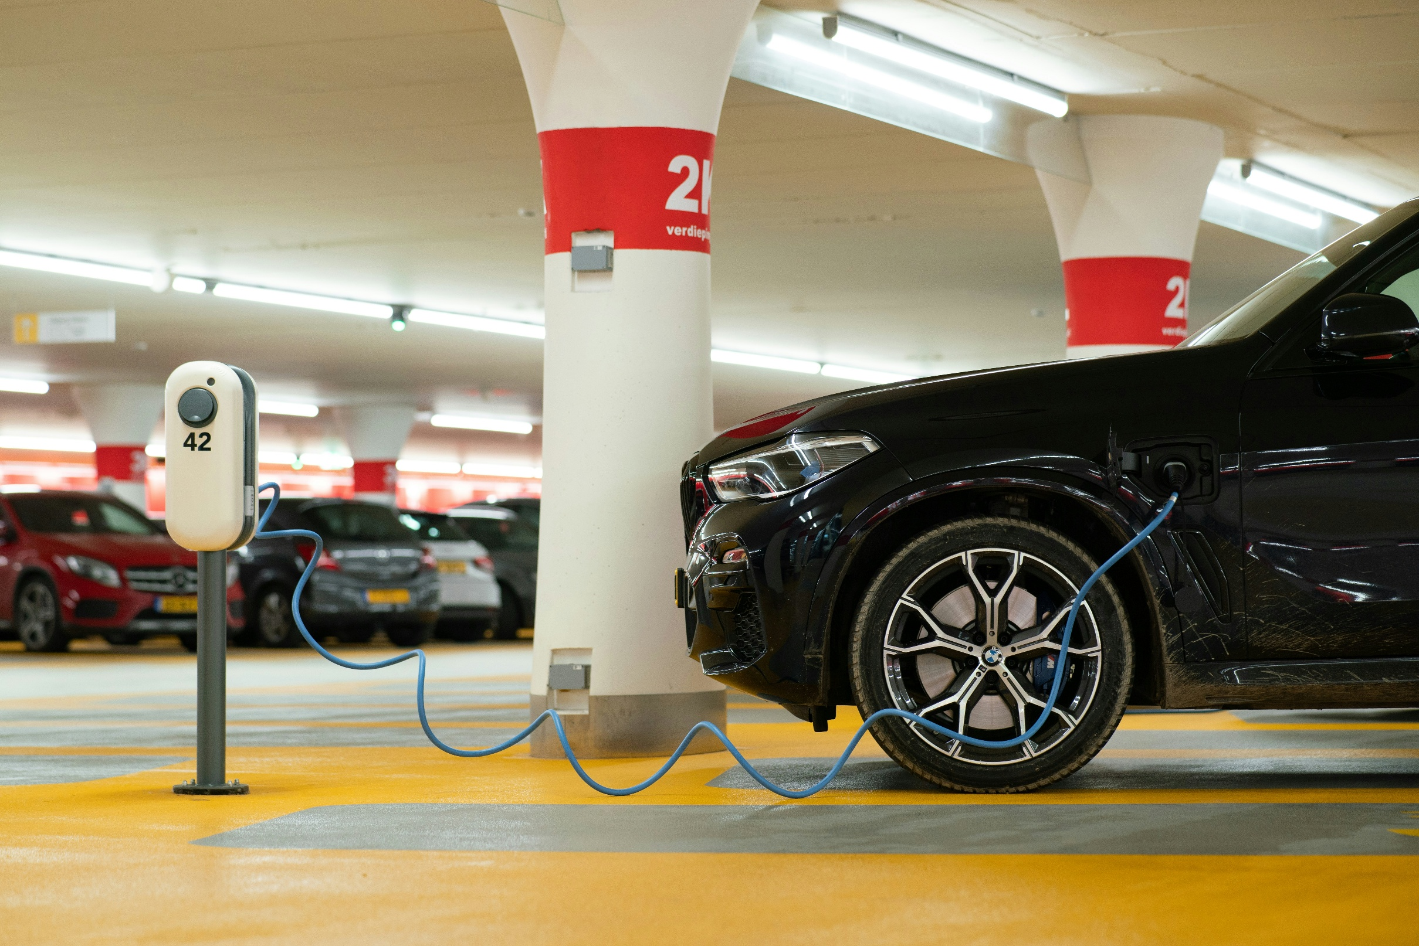
Future of
EV Battery Chemistry
Research Highlights

Slide 2
The global EV battery market will grow from $91.93B (2024) to $251B by 2035, with a 9.6% CAGR. This growth is driven by regulations on emissions, the shift to renewable energy, and heavy investments in EV infrastructure.
Lithium-ion batteries dominate, but rising demand for longer ranges and faster charging is pushing advancements in battery chemistry. Sustainability efforts, including ethical sourcing and recycling, will also shape the future.
The Asia Pacific region, led by China, continues to be a dominant force in the market, influencing trends globally. Additionally, the demand for EV batteries is expanding beyond passenger vehicles to include electric buses, trucks, and energy storage systems.
As EV adoption grows, battery innovations will be key to the 7x growth in demand by 2035, ensuring the success of the EV revolution.
Executive Summary

Slide 3
EV Battery Innovation Is Shifting from Incremental Improvements to Breakthrough Technologies
Current Technologies :
Lithium-ion Dominance - High energy density, Long cycle life & Falling costs
Chemistry Variants:
Next-Gen Technologies
1
NMC – Balanced performance
NCA – High energy, premium EVs
LFP – Cost-effective, safer
LMFP – LFP with higher density
1
Solid-State – Safer, higher density
Silicon Anodes – Higher capacity
Sodium-ion – Cost-effective, abundant
Advanced BMS – Smarter performance, safety
Executive Summary
2
2
3
3
4
4
Ongoing Improvements: Enhanced thermal management, Better structural integrity & Advanced electrode materials and cell design
The EV battery market is at a pivotal moment: while lithium-ion advances continue, innovation in solid-state, silicon anodes, and sodium-ion chemistries points to a safer, more efficient, and sustainable future.

Slide 4
EV Battery Market Outlook: Growth, Chemistry Shifts
& Cost Drivers
$91.93B (2024)
$251B by 2035
Estimated CAGR (2024–2035) 9.6% – 25.95%
Year | Projected Market Size
2030 USD 215B – 322B
2035 UDS 251.3B
Executive Summary
Cathode share: 50.9% → 30% Key driver: Chemistry innovation & material shift

Slide 5
Competitive Landscape of the EV Battery Market: Key Players and Market Shares
Company | Dominant Chemistry | Innovation | Strategy Focus
CATL | LFP, Sodium ion | 1500 km range battery, 5-min 520 km charging, sodium-ion mass production (2025) | Cost-efficient chemistries, scale-up
BYD | LFP | Blade Battery: ultra-safe, cobalt-free LFP, high durability, space efficiency | Vertical integration, Blade Battery
Tesla | NMC (811 → 955); testing NMC 973 | Energy density upgrade, local supply chain, cost optimization (IRA credits) | Upgraded 4680 cells (+20% energy), in-house cathode & lithium plants, scaling U.S. production
LGES | Mid-nickel NCM, LFP (planned for 2026) | - Focus on reducing EV battery costs - Mass production of LFP batteries by 2026 - Dry manufacturing process to reduce costs | - Mid-nickel NCM: 40-60% nickel, lower cobalt, 10% cheaper - Increased energy density (700 Wh/L) - Dry process to cut manufacturing costs
SK On | High-nickel (SF, SF+), LFP (Winter Pro) | Fast-charging, energy storage systems (ESS), and low-temperature battery performance. | - SF & SF+ Batteries: Faster charging (15-18 mins) with higher energy density (+9%). - Winter Pro LFP Battery: Better performance in low temps (+16% charging capacity, +19% energy density). - Non-washing Cathode Process: Improved battery efficiency without water washing.
CATL, BYD, LG Energy, and SK On dominate the battery market, with advancements in fast-charging and energy density enhancing their market share. Tesla leads through vertical integration and innovation in battery technology

Slide 6
Key EV Battery Challenges
Opportunities in EV Battery Chemistry
Raw material volatility risks reversing declining battery cost trend
Limited and uneven charging infrastructure
Battery life concerns and performance degradation
Safety risks, including thermal runaway
Advanced BMS for optimized performance & longevity
Lower EV operating costs vs. ICE vehicles
Strong ESG impact: emissions & public health
Second-life battery reuse for energy storage
India on the Electric Highway: The Nation's EV Trajectory
Key Trends:
Passenger EV share of total passenger vehicle:
1
India's EV market is currently small, accounting for about 2.5% of all car sales in 2024.
Schemes like FAME and PLI to boost both adoption and local manufacturing.
Electric two-wheelers currently dominate EV sales in India, followed by three-wheelers.
EV production projected to soar by 140.2% year-over-year to approximately 301,400 units
Summary: While currently a small segment of the overall automotive market, India's EV sector is poised for significant expansion, fueled by strong government support, increasing domestic production, and growing consumer interest.
2
3
4

